Slide 1



UNIVERSITY INSTITUTE OF ENGINEERING
COMPUTER SCIENCE ENGINEERING
Bachelor of Engineering
Design and Analysis of Algorithms(CST-311/ITT-311)
Topic: SORTING
DISCOVER . LEARN . EMPOWER

Slide 2
Learning Objectives & Outcomes
Objective:
To understand the merge sort, quicksort and selection sort using divide and conquer.
Outcome:
Student will understand
Merge Sort
Quicksort
Selection sort

Slide 3
Merge Sort
Merge Sort is a Divide and Conquer algorithm. It divides input array in two halves, calls itself for the two halves and then merges the two sorted halves. The merge() function is used for merging two halves. The merge(arr, l, m, r) is key process that assumes that arr[l..m] and arr[m+1..r] are sorted and merges the two sorted sub-arrays into one.

Slide 4
MergeSort(arr[], l, r)
If r > l
1. Find the middle point to divide the array into two halves:
middle m = (l+r)/2
2. Call mergeSort for first half:
Call mergeSort(arr, l, m)
3. Call mergeSort for second half:
Call mergeSort(arr, m+1, r)
4. Merge the two halves sorted in step 2 and 3:
Call merge(arr, l, m, r)

Slide 5
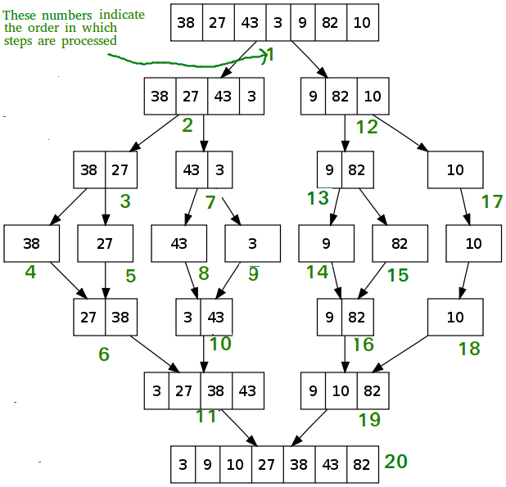

Slide 6
Algorithm
1. Algorithm MergeSort(low,high)
2. //a[low:high] is a global array to be sorted
3. //Small(P) is true if there is only one element
4. //to sort. In this case the list is already sorted.
5. {
6. if (low<high) then //if there are more than one element
7. {
8. //Divide P into subproblems
9. //find where to split the set
10. mid = [(low+high)/2];
11. //solve the subproblems.
12. mergesort (low,mid);
13. mergesort(mid+1,high);
14. //combine the solutions .
15. merge(low,mid,high);
16. }
17. }
Time complexity of Merge Sort is Θ (n log n) in all 3 cases (worst, average and best) as merge sort always divides the array into two halves and take linear time to merge two halves.

Slide 7
QUICKSORT
Quicksort is a sorting algorithm whose worst-case running time is (n²) on an input array of n numbers. In spite of this slow worst-case running time, quicksort is often the best practical choice for sorting because it is remarkably efficient on the average: its expected running time is (n lg n), and the constant factors hidden in the (n lg n) notation are quite small. It also has the advantage of sorting in place (see page 3), and it works well even in virtual memory environments.

Slide 8
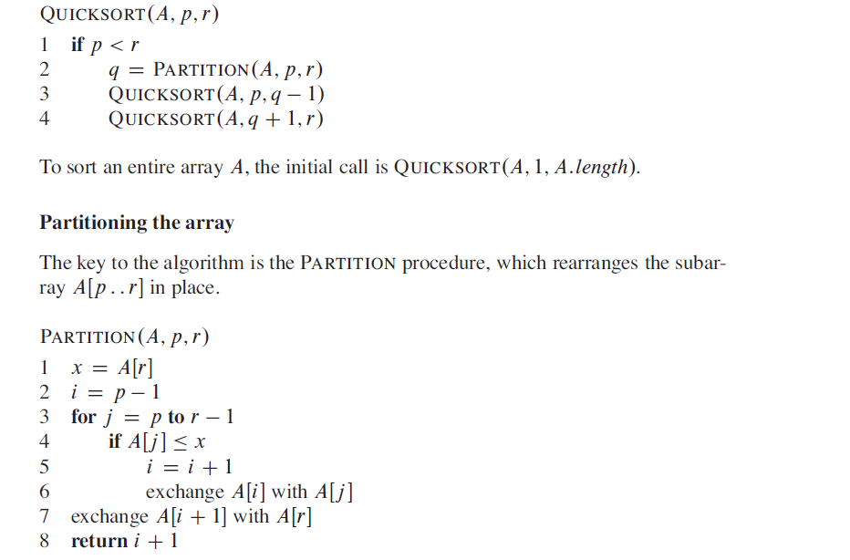

Slide 9
Selection sort
Selection sort is a simple sorting algorithm. This sorting algorithm is an in-place comparison-based algorithm in which the list is divided into two parts, the sorted part at the left end and the unsorted part at the right end. Initially, the sorted part is empty and the unsorted part is the entire list.
The smallest element is selected from the unsorted array and swapped with the leftmost element, and that element becomes a part of the sorted array. This process continues moving unsorted array boundary by one element to the right.
This algorithm is not suitable for large data sets as its average and worst case complexities are of Ο(n²), where n is the number of items.

Slide 10
Algorithm
Step 1 − Set MIN to location 0
Step 2 − Search the minimum element in the list
Step 3 − Swap with value at location MIN
Step 4 − Increment MIN to point to next element
Step 5 − Repeat until list is sorted

Slide 11
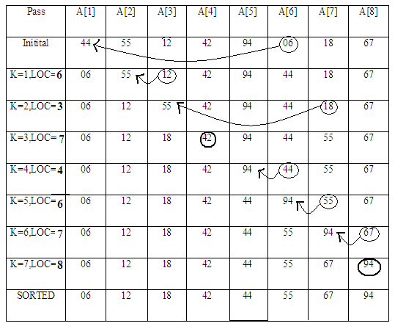

Slide 12
REFERENCES
Text books:
Cormen, Leiserson, Rivest, Stein, “Introduction to Algorithms”, Prentice Hall of India, 3rd edition 2012. problem, Graph coloring.
Websites:
https://www.geeksforgeeks.org/merge-sort/
http://staff.ustc.edu.cn/~csli/graduate/algorithms/book6/chap08.htm
https://www.tutorialspoint.com/data_structures_algorithms/selection_sort_algorithm.htm

Slide 13
Summary
  Divide and Conquer:
    Merge Sort
    Quicksort
    Selection sort

Slide 14
THANK YOU

